Slide 1
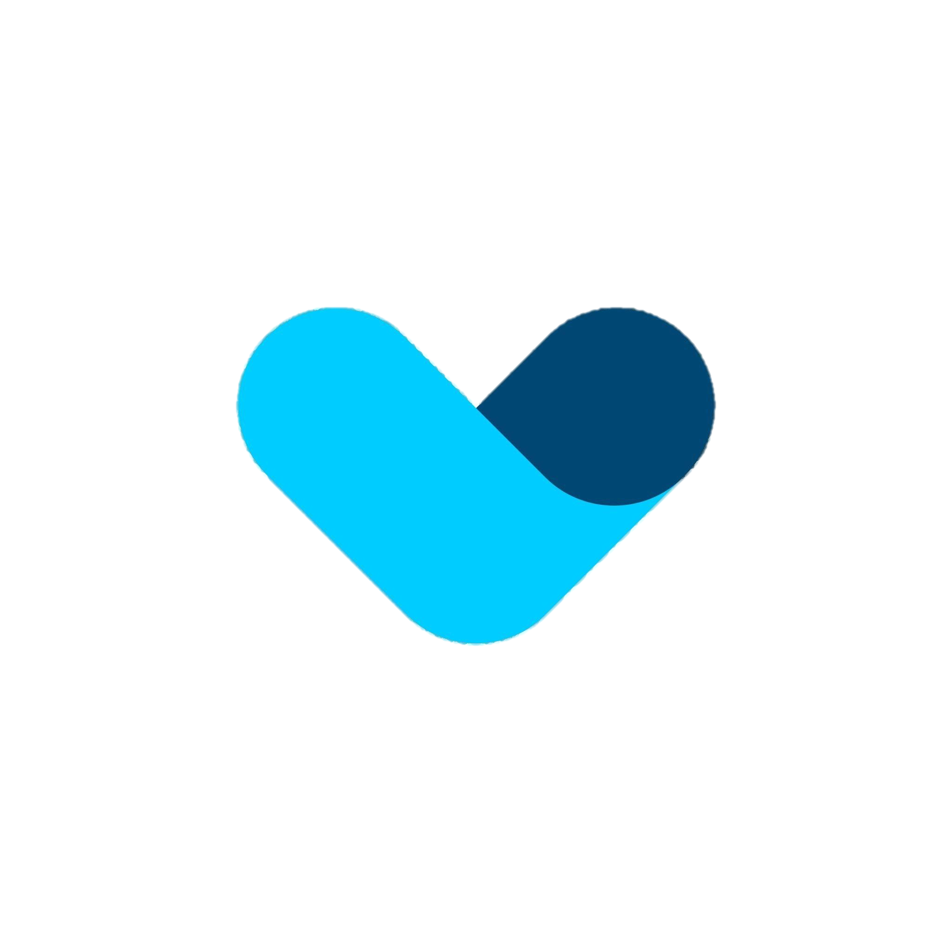
Micro SAAS Startup Session 1
SAAS Startup Session

Slide 2
Selecting a customer Acquisition channel Identify Your Constraints
Time: Is there a specific window for reaching your target audience
SAAS Startup Session

Slide 3
Testing an MVP
Ad Campaigns: Run targeted ads on platforms like Google and Facebook to gauge product appeal.
Fundraising: Use crowdfunding platforms like FundKiss to validate market interest and engage early adopters.
Concierge MVPs: Deliver a customized service to select customers, revealing customer preferences.
Single-Feature MVPs: Focus on one core feature to simplify development and user focus.
Pre-Order Pages: Present your product to potential customers, enticing them to purchase before it's built.
SAAS Startup Session

Slide 4
Micro SAAS Best practices for startups
Avoid offering free trials.
Prioritize upfront cash payments, with a preference for longer commitments
Steer clear of monthly subscription models.
Directly target the decision-maker when selling your product or service,
If a trial is necessary, limit its duration,
with preference for shorter periods (1 day or 1 week).
(2 years, 1 year, 6 months).
rather than relying on their subordinates.
SAAS Startup Session

Slide 5
Getting first 100 Customers – Speed factors
Depends on how urgently is your solution needed to the customer’s problem
Number of referrals from industry experts
find promoters for your product, offer their options such as commission fees
For example universities promotes jobs of MNC and SMEs,
SAAS Startup Session
SaaS/B2B - How to Get Your First 100 Customers - YouTube

Slide 6
Pricing strategy
Price: market value but if no competition then price is based on the business value that you provide to your customer,
will they be able to make 1000$ from what you teach them
or will your product save them 1h of work everyday, depending on their hourly rate, its saving them money
SAAS Startup Session
SaaS/B2B - How to Get Your First 100 Customers - YouTube

Slide 7
Pitfalls to avoid with large target market/cheap price
Avoid replying to customers If your product is priced cheap,
instead automate the process through a sign up page for efficiency
large customer bases cannot be supported at low hourly cost
Avoid doing customer training calls every week
Only offer training seminars to a batch of customers at once. Up to 100 customers on a recorded call at once
SAAS Startup Session
SaaS/B2B - How to Get Your First 100 Customers - YouTube

Slide 8
Cutting costs
"Software hosting and database — Managed with free credits from AWS Activate + Azure Bizspark.
Authentication service with Auth0, free upto 7000 users.
Google Analytics for clickstream analytics.
Loggly — used the free plan for log analysis.
ElasticEmail offers upto 150k free emails a month.
Msg91 for startups — Received free credits for sending transactional SMS.
CRM — Free plan with Zoho.
Calendly — for scheduling meetings.
Asana — for task management "
Here’s how we built and launched a SaaS startup for INR 2.6 lakhs | by Abishek Baskaran | Startups & Venture Capital (startupsventurecapital.com)
SAAS Startup Session

